Slide 1
Movie Genre Predictor with NLP
X-cessive Ambassador: Niki Patel & Alli Sklar

Slide 2
Purpose and Motivation
We wanted to create a fun and interactive site that would predict the movie’s primary genre based off the movie’s plot summary. In order to achieve this goal, we had to use natural language processing and multi-classification.
Notes:
Future usage, this can be a starting step to see how much of a particular genre the movie is. Or if someone wanted to know how scary or how funny a movie is.

Slide 3
Data Sources & Tools Used
Data Sources:
Retrieved CSV file with movie title names and IMDB IDs from MovieLens
Created OMDB API keys and retrieved movie information (IMDB & OMDB share the same movie ID numbers)
Tools Used:
Scikit Learn’s Text Data module (Chi2, CountVectorizer, and TFIDFTransformer) . We also used Scikit Learn’s Logistic Regression, Linear SVC, and Naive Bayes to test the performance of the model, Scikit Learn’s metrics to measure accuracy of the model.
Pandas, Numpy, Matplotlib, HTML, CSS, Materialize, and Python Flask

Slide 4
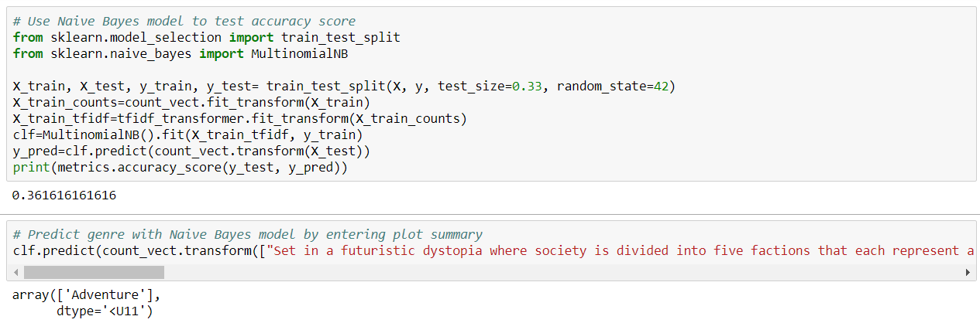
NLP with Naive Bayes

Slide 5
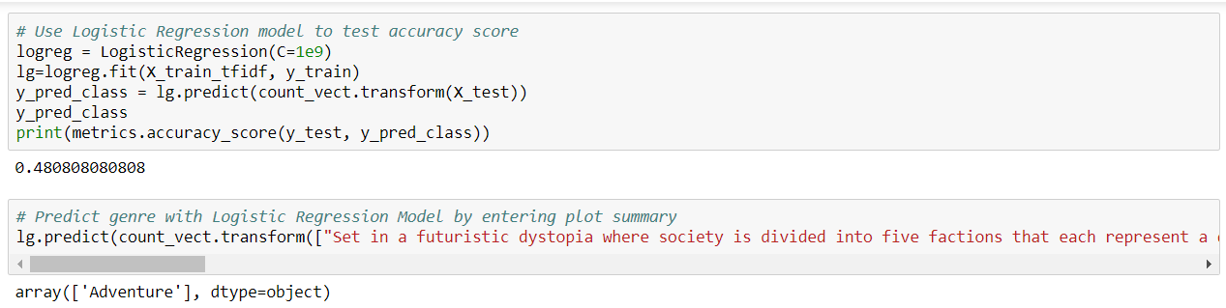
NLP with Logistic Regression Model

Slide 6
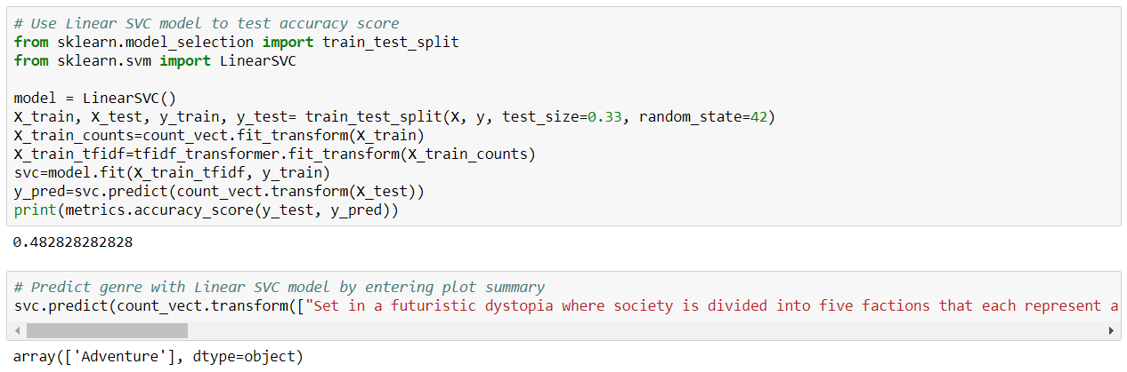
NLP with Linear SVC

Slide 7
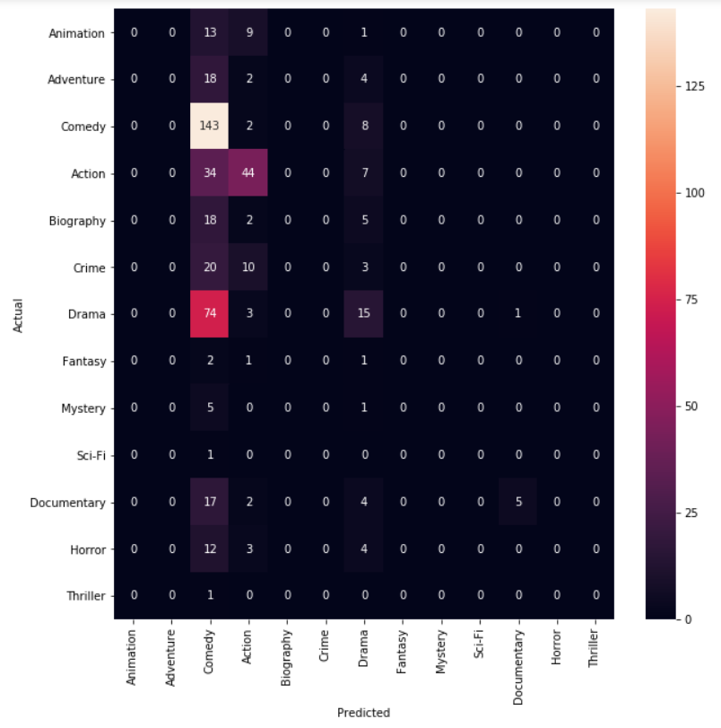
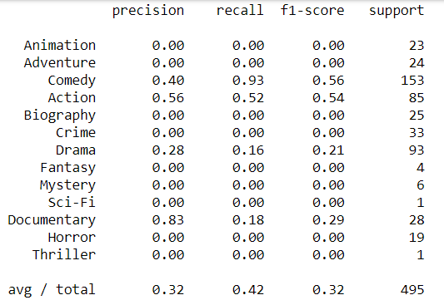
Confusion Matrix & Classification Report with Linear SVC

Slide 8
Conclusion
Natural Language Processing is HARD. Through some research, we found out that multi-classification is still in the process for major improvements. We found that most people who have done multi-classification projects do have misclassifications.
Ways we would improve on this project if more time was give would be to…
Study & familiarize ourselves with the XGBoost & Words2Vec and incorporate that into our model in hopes of improving our accuracy score.
Retrieve more data to test and train.
Notes:
The other difficulty with this project is the fact that movies aren’t always classified into one genre. Doing model predictions with multiple categories is something to further explore.

